Slide 1

Lecture
on
“Advanced Computer Architecture –TCS 704”
by
Akansha Gupta
DEPARTMENT OF COMPUTER SCIENCE AND ENGINEERING
GRAPHIC ERA DEEMED TO BE UNIVERSITY – 248002

Slide 2
INSTRUCTION LEVEL PARALLELISM

Slide 3
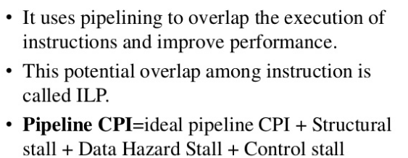
Instruction Level Parallelism(ILP)

Slide 4
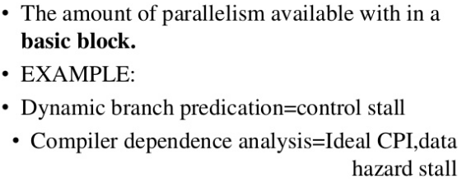
What Is ILP?

Slide 5
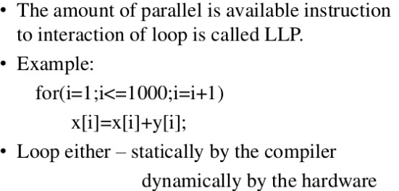
Loop Level Parallelism(LLP)

Slide 6
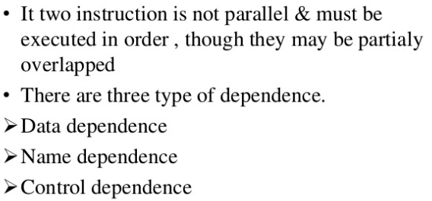
Data Dependence and Hazard

Slide 7
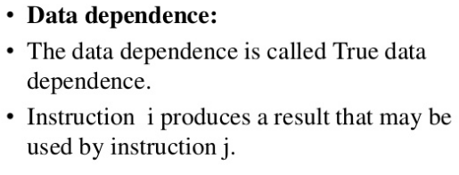
Contd…

Slide 8
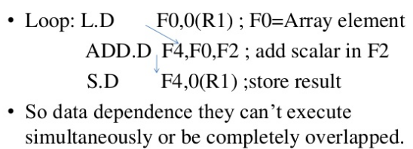
Example

Slide 9
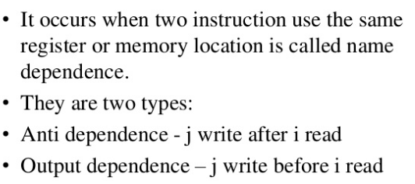
Name Dependence

Slide 10
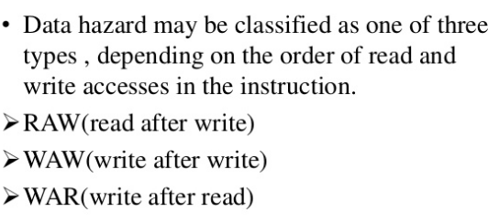
Data Hazard

Slide 11
https://youtu.be/JkwT8rShdY8
THANKS

